Slide 1
Student Leadership Nomination 2017-18 Years 7 - 10

Slide 2
Why nominate?
Become more self-aware
Improve decision making skills
Help others
Build relationships
Improve school culture
Develop self confidence

Slide 3
Nomination Process
Nomination forms to your email account on Monday 26 June
You may only nominate for ONE leadership group
Incomplete forms will not be considered
Nominations close on Thursday 27th July 2017
Leadership Group | Arts Council | Sports Council | SJC | SRC
Number of positions | 4 | 4 | 4 | 4

Slide 4
Nomination Process
Students who have been placed on Level 3 or 4 in the calendar year of nomination are not eligible to nominate.
Students who have been placed on Level 1 or 2 in the calendar year of nomination will have their nomination reviewed by the leadership group coordinator.
All student records will be consulted in considering eligibility

Slide 5
Complete the nomination form for the Leadership Group that suits YOU.
Write a response explaining why you would be a good leader

Slide 6
Am I suited?
What is expected?
Get endorsement by the due date

Slide 7
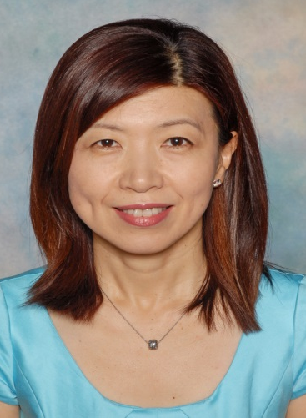
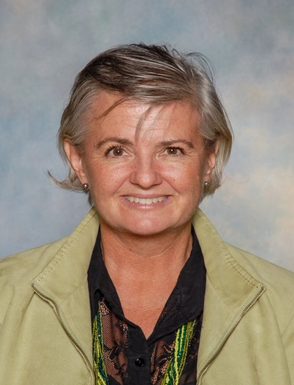
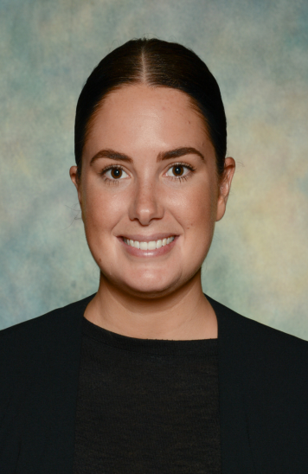
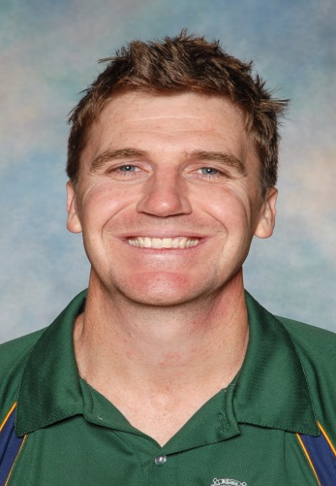
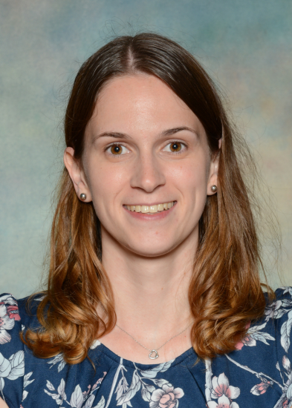
Submit your completed nomination forms
Arts Council
Ms Kim
Prefects
Ms Black
SRC
Ms Kydd
SJC
Ms Bouchier
Sports Council
Mr Bruckshaw

Slide 8
Nominations close on Thursday 27th July 2017. Good luck!
✓ Get involved in your school!!

