Slide 1
information for parents
Managing Year 12
and
the HSC
23rd March 2016
Notes:
SC

Slide 2

WELCOME
Deputy Principal – Carla Marchesin

Slide 3

EXPECTATIONS
Principal – Jane Dennett
Notes:
Links to JD ppt

Slide 4
The HSC - what’s a parent to do?
Should he keep his part-time job?
The door’s shut, but is she studying in there?
He won’t talk to me about how much work he’s doing.
Is it really studying if there’s music playing?
She lies on the floor – shouldn’t she be sitting at the desk?
Shouldn’t he know what he wants to do by now?

Slide 5
For what it’s worth …
The HSC is teenagers’ first chance to discover their independence – no-one else can do the work for them.
Stand back and let them do it – or not do it – their own way.
Start with the basics: diet, sleep, exercise, limits on socialising, a structured routine
Parents have an important role to play, but it is psychological more than active (Robyn Chellew). By Year 12, students need to take responsibility for themselves, but still need support from home.
It can be a fine line between support and judgement – listening is key.
Work can have real benefits – but no more than 10 – 12 hours.

Slide 6
Some tips from an expert:
Dr Fred Orr, psychologist & author
Guide, support and encourage your child.
Don't nag.
Don't tell them they will fail if they don't work harder.
Encourage healthy eating, regular exercise and plenty of sleep.
Take their efforts seriously.
Create an effective work space in the house.
Take a whole-family approach to supporting the student.
Don't overload them with domestic chores – but don’t remove all of them.

Slide 7
Let them know that you're there when they need you.
Encourage them to believe in themselves.
Remind them of their goals.
Give them positive feedback whenever possible.
Remember the exam is about them, not you.
Encourage them to take study breaks when necessary.
Help them put the year in perspective.
Keep an eye on their emotional health; look for changes in sleeping or eating and see your local doctor if concerned.

Slide 8
Expectations
We expect that each student:
works to maximise their opportunities for success
respects the rights of others
accesses support when they need it
acts in such a way that brings credit to themselves and our school
is able to celebrate their achievement with dignity

Slide 9
The rules
School staff must not encourage or condone the use of alcohol by students of any age during educational activities (DEC Code of Conduct)
Principals must manage incidents involving alcohol consistent with the school's student welfare and discipline policies and Suspension and Expulsion of School Students Procedures (DEC Drugs in Schools Policy)
A person must not supply liquor to a minor on any premises unless the person is a parent or guardian of the minor (NSW Liquor Act 2007)

Slide 10

ORGANISATION
Stage 6 Head Teacher – Christine Black
HSC Structure
Timetables - terms
Year 11 and Year 12
Assessments, exams
PIN
www.boardofstudies.nsw.edu.au
Notes:
The Higher School Certificate (HSC) is the highest award in secondary education in New South Wales. To be eligible for the award, students must complete Years 11 and 12, satisfy HSC course requirements and sit for the statewide HSC examinations.
Complete 12 units = yr 11
Complete 10 units Yr 12
TIMETABLES
Term1 – Half yearly exams
Term 2 – exam timetables
Term 3 – Trials
Term4 – 13 OCT 2016 – 4 NOV 2016 external exams
15 December 2016 HSC results released
PIN
Sent via email or posted. There is also a phone number to call.
Check you are enrolled in the correct courses
See your personal HSC exam timetable Students Online
See your results including HSC results (from 15 December 2016)
Change your PIN

Slide 11

HSC vs ATAR
BOSTES – Board of Studies Teaching and Educational Standards
http://www.boardofstudies.nsw.edu.au/
Universities Admissions Centre
http://www.uac.edu.au/

Slide 12
Exam equipment
Black pens
Pencils & erasers
Ruler
Highlighter pens
Clear water bottle
Watch (must be put on desk)
Specific equipment for subjects
Notes:
Equipment for specific HSC exams
This list details specific equipment that students are expected to provide for particular examinations. Only those examinations that require specific equipment are listed.

Slide 13

NOT allowed
Mobile phones
Paper or printed materials
Correction fluid
Dictionaries

Slide 14
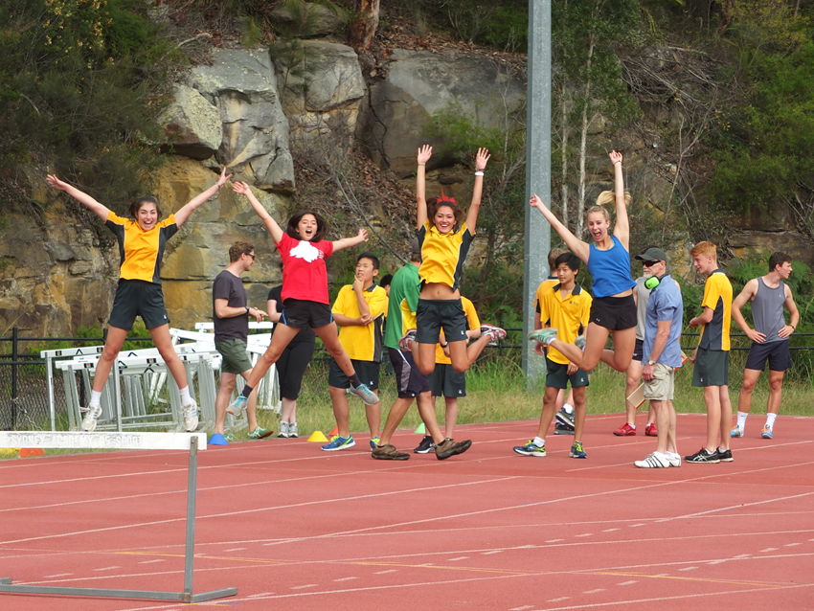
What to do?
        Eat & sleep
        Be on time
        Be prepared
Notes:
Be on time – plan your time. Be efficient – make a plan and don’t waste time
Be prepared – Be active – actively study – verbalise, visualise. Look after yourself – food water and sleep
Listen – instruction, guides, hints .....

Slide 15

Year 12 Advisers
Mrs Melinda Buxton, Mr Dane Le Rougetel and Mrs Daniella Costa
What is coming up for Year 12
End of year events: Ekuba, Picnic and Formal
Notes:
Melinda – Ekuba: what is Ekuba? ‘Ekuba’ means ‘farewell’ or ‘goodbye’ in the ancient Aboriginal language of Kutthung. The annual Ekuba dinner, held since 1992 in the Kerrabee Hall, is now a long-held tradition at Killara High School and a much anticipated event for Year 12 students and their families, organised by the parents of year 11 2016. This year, it will be held on Thursday 22 September 2016 when Killara High will officially say ‘Ekuba’ to our 2016 Year 12 class before the final rigours of study and exams. All Year 12 students and their parents/caregivers are invited to a delicious, professionally catered sit-down dinner which will be part of a memorable evening of celebrations, presentations and reflections from staff, parents and students. The ticket limit per student is a maximum of 3 tickets, one for the student and they can invite up to two guests. When booking you will have the opportunity to nominate a couple of other students/families you would like to sit near and the caterers will cater for any dietary requirements.
Dane –
Danni -

Slide 16

If something goes wrong?
Head Teacher Welfare – Jane Rountree

Slide 17

There will always be Crises
Every year difficult situations occur, some relatively minor, and some more traumatic.
The BOSTES are well prepared for almost every eventuality.
The consequences are rarely as catastrophic for the student as family may fear.
Talking to school support personnel is the best way to deal with whatever happens to students in their home or school life.

Slide 18
There will always be Crises!
Every year difficult situations occur, some relatively minor and some more traumatic.
The BOS are well prepared for almost every eventuality.
The consequences are rarely as catastrophic for the student as family fear.
Talking to school support personnel is the best way to deal with whatever happens to the students in their home or school life.

Slide 19
Disability Provisions
The BOSTES recognises that for some students, the conditions of the examination room or of their own circumstances might mean that they are disadvantaged, so provisions can be applied for that will make the actual sitting for the exam easier.
This does not mean extra marks for any student
The BOSTES is still very reluctant to provide for the option of writing on a computer. This is usually only offered if there are significant physical disabilities.

Slide 20

Common Provisions
The most common Disability Provision is for separate small group supervision, away from or adjacent to the main examination hall.
Where assessment tasks are being carried out in a classroom this provision is not applied, as the class group itself constitutes a small group.

Slide 21
Rest Breaks
Students can be granted the opportunity to take rest breaks from writing their exams in order to refocus their attention or exercise some calming techniques such as breathing.
The breaks are taken at a rate of 5 mins per half hour for the length of the examination. They must take 5 min breaks at a time.
Rest breaks are timed and the student is accorded the accumulated time at the end of the examination time.

Slide 22

Extra Time to Write
Extra time for students to write is very rarely provided.
Extra time is usually associated with physical disability which handicaps the student’s ability to write.
Students can apply for a scribe, however dictating to a scribe is a skill and many students dislike doing this

Slide 23
What if something goes wrong at the time of the examinations?
Illness /Misadventure applications can be made for situations that arise at the time of examinations or assessments.
The forms appear in the students’ assessment booklets.
A form should be submitted with the appropriate medical certificate that covers the precise time that the examination was held.

Slide 24
Illness/Misadventure
The BOS recommends attending and attempting examinations if at all possible plus submitting an Ill/Misad form in case the student performs significantly below their normal performance level.
Illness/ Misadventure forms must be submitted on the first day of return to school or during the HSC before the conclusion of the timetabled exams.

Slide 25
5 free marks?
EAS - Educational Access Scheme.
These applications do not become available until mid-August.
Application is made to the University Admissions Centre in the event that there has been a long term family background issue or illness that may have impacted on a student’s capacity to perform to the best of their ability in the HSC.

Slide 26
Documentation
The EAS application requires quite a deal of documentation, including medical legal statements, Centrelink statements, statutory declarations or proof of family events and crises.
There is a booklet that accompanies the application form. This details the required documents for each category of application. Students are required to make a statement, and to submit photocopies of all documents that have been verified by a JP.

Slide 27
Educational Impact
The school is the last to write on the form and school personnel must be the people to describe the educational impact of the circumstances pertinent to each student.
This means that we need to know about the circumstances, and the more that we can cite phone calls, contact with family, counsellor interviews and so on, then the stronger our support can be.

Slide 28



Communication!

Slide 29
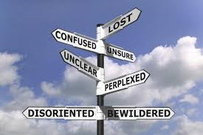
COunselling
Counsellor – Emmy Druce

Slide 30

Careers
Careers Adviser– Sophie Allen

Slide 31
Careers
Student interviews
School Newsletter for upcoming events
Career Seminars April 7 - 1. Industry Trends 2.University Application & Scholarship Writing
Lunchtime Presentations – Universities, Scholarship & Cadetship programs, Gap Year etc
NS5 Careers Expo St Ives HS Tues August 16 5.00-8.00pm
UAC – Universities Admissions Centre
Notes:
Students are encouraged to make appointments with the careers adviser – Discussions might include post school pathways (having a plan A and B), ATAR results, bonus points, university applications, scholarships and general careers information.
All of the latest careers information can be found in the school newsletter which is issued fortnightly
Option careers seminars on April 7 for students - $5 for one session or $10 for both. The cost has been subsidised by the careers faculty as we feel it is really important for students to make informed careers choices and use labour market information to help them. Also key for students to learn about the application processes as some university courses require this and often students have difficulty articulating what is required especially when they have to write about themselves, this can be difficult.
Lunchtimes – various free presentations across terms 1-3 from colleges, universities and other institutions. Encourage students to attend where relevant to them and their interests.
NS5 Careers Expo which will be on August 16 at St Ives High School – free and have representatives from various universities and institutions that are chosen carefull to meet the needs of our students
UAC information – students are guided through the process in term 3 – please see the hand out for more specific details

Slide 32
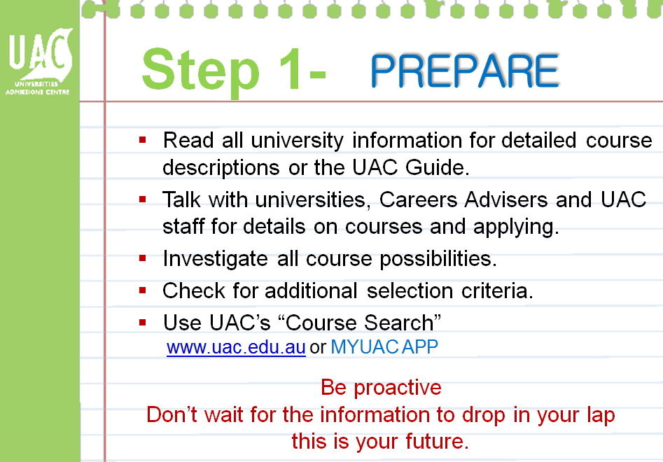

Slide 33
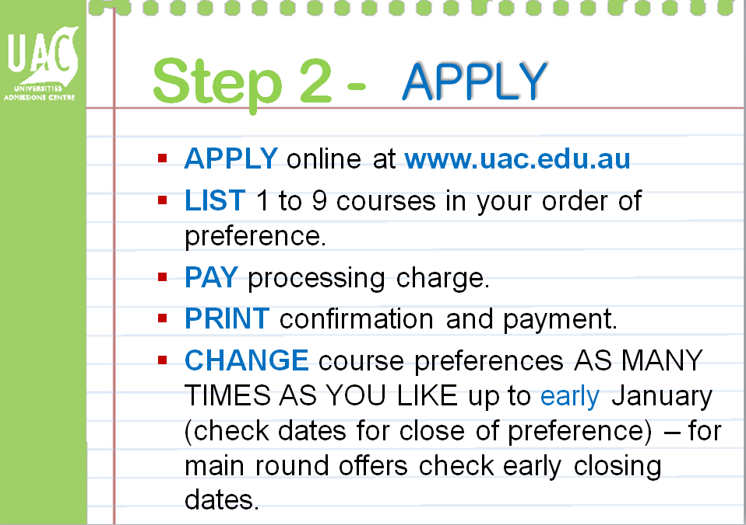

Slide 34
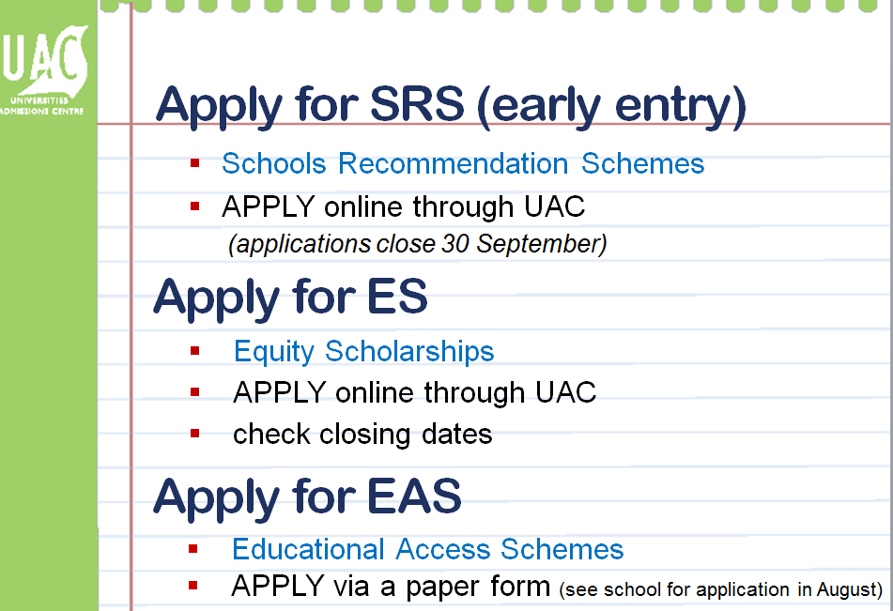

Slide 35
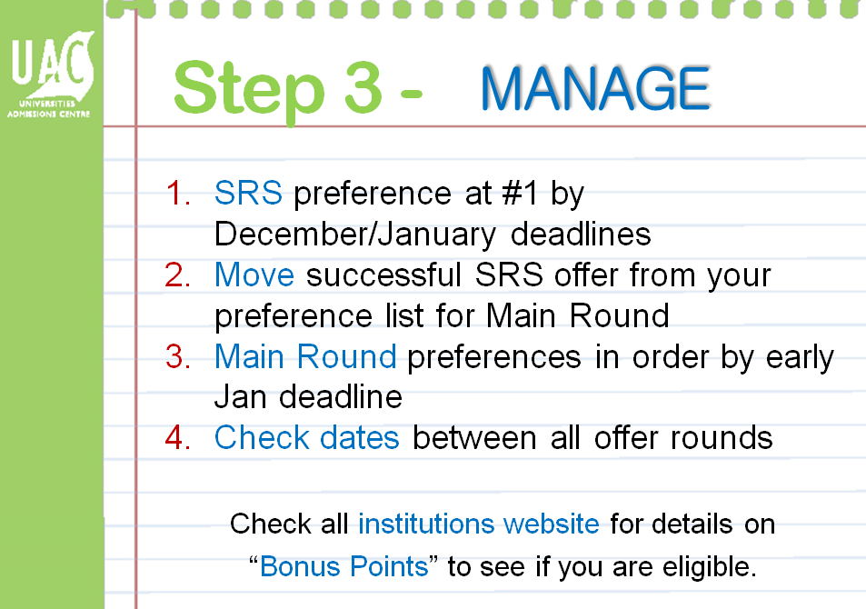

Slide 36
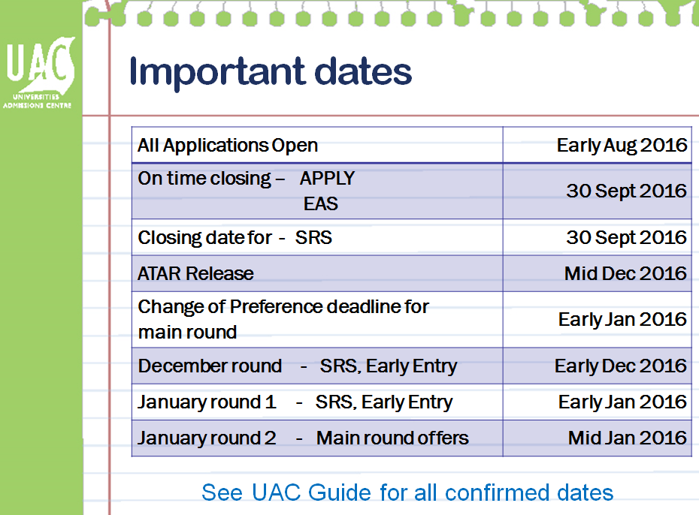

Slide 37


Slide 38

Beyond the HSC
UAC applications
Undergraduate Scholarship Applications
TAFE applications
Open Days
Notes:
Newsletter

Slide 39

Message …..
Take it easy
…….one step at a time
Notes:
Be active – actively study – verbalise, visualise
Maintenance – food water and sleep
Fuel efficient – make a plan and don’t waste time
Hard work – what you put in – you get out.
Make a plan – a place to study, a time to study, keep up to date!!!!!

