Slide 1
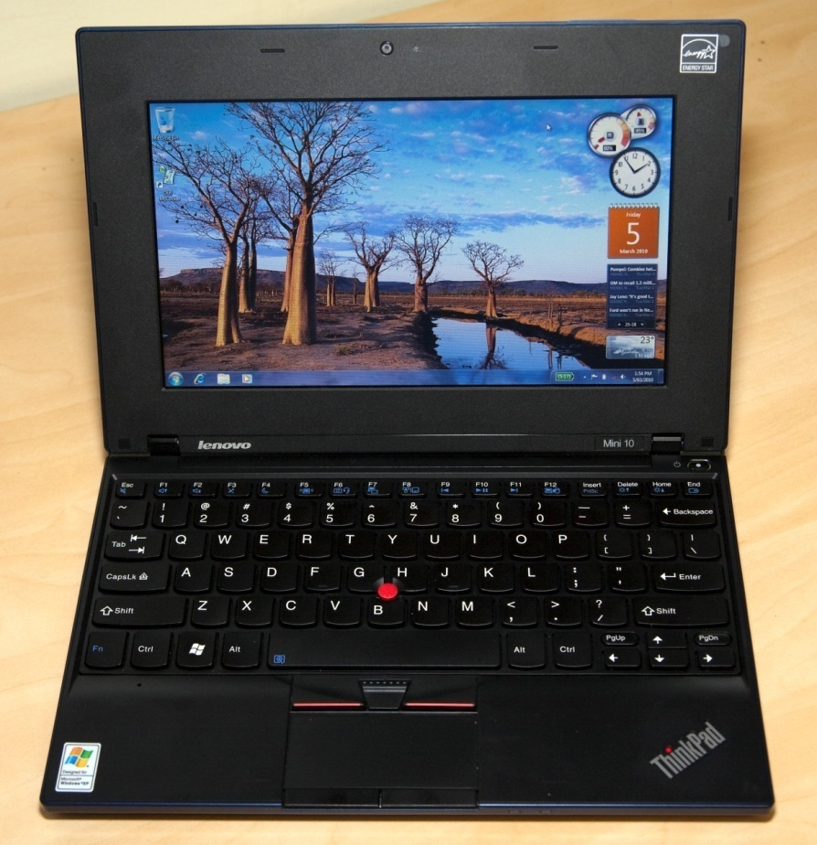
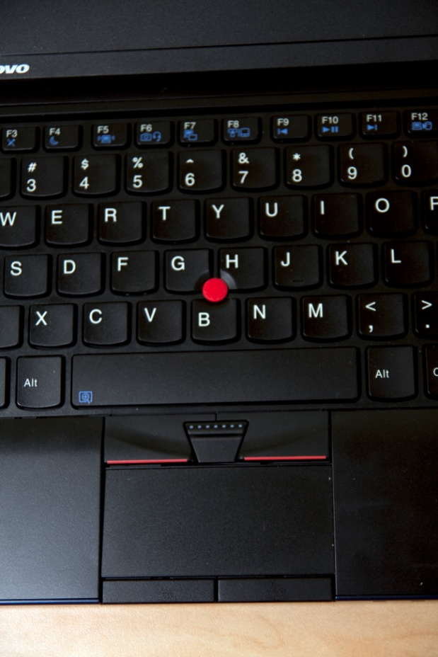
Digital Education Revolution
Killara High School
Year 9 – 2010

Slide 2
The Digital Education Revolution
The DER is a Federal initiative.
Prime Minister Rudd promised Children Yr 9 – 12 access to a computer.
The laptop program is NSW DET’s implementation of that promise.
Laptops will be rolled out each year to Yr 9 students until 2012.
By 2012, all students in Yrs 9 – 12 will have a laptop.
The program also includes a high speed wireless network, laptops for staff, staff training and technical support.

Slide 3
What’s happening at Killara HS..
Laptops have arrived.
Have been allocated to Yr 9 Students.
Will be handed out after receiving Signed USER CHARTER.
A number of rooms are already on the wireless network in Phase 1 of the cabling project. More are currently being added in Phase 2 and phase 3.
Some staff have laptops. More will be issued in the future.

Slide 4
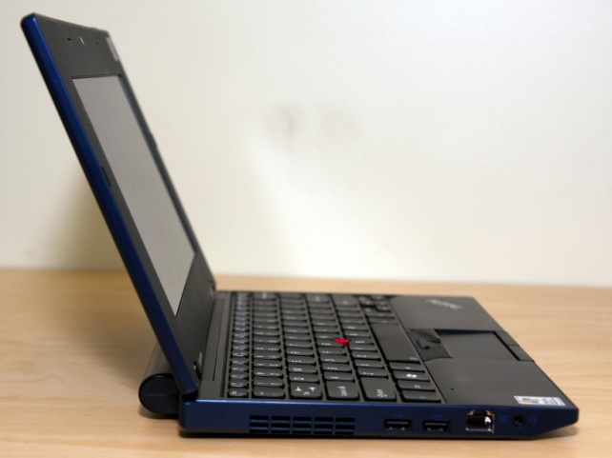
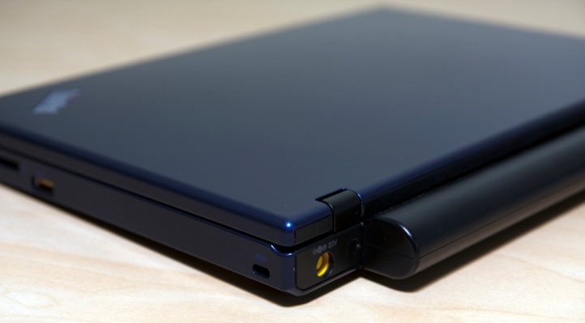
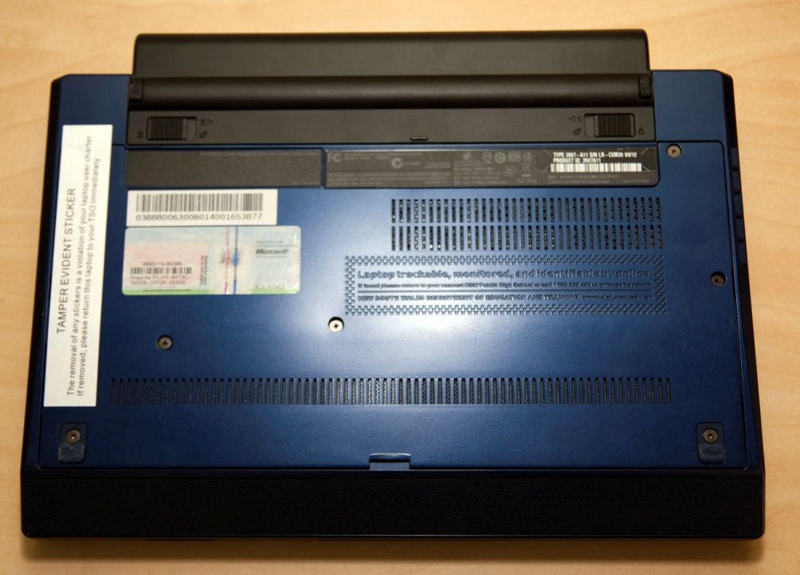
The Laptop

Slide 5
Features of the Laptop (Hardware)
Impressive processing capabilities with the latest Atom N450 CPU and 2Gig of RAM
Plenty of storage space with a 160gig HDD with an active protection “air bag” anti-shock system.
Wireless connection – Bluetooth
Microphone and webcam
Standard netbook keyboard with full size keys and touch pad
High resolution 10.2 inch screen at 1280x720 resolution
3 USB ports
Long lasting battery – will last 7+ hours.
Charger and plastic case
Customised for the DER project
1.5kg in weight
Anti-tamper stickers
1. Integrated Camera
2. Computer display - The colour display with TFT
3. Power button (Use the Power button to turn on the computer.)
4. Microphone (built-in)
5. (Not used)
6. Wireless device switch

Slide 6
Features of the Laptop (Software)
Over $5000 worth of software installed!!
Full Microsoft Office software
Word, Excel, Access
Adobe Suite software
Photoshop Elements, Premiere Elements
Various other software for
Mathematics, Music, Geometry, Webcam video and still photos, Drawing, Google Earth, iTunes
Protection:
Full Microsoft anti-virus and anti-spyware protection as well as Blue Coat internet filtering
NOTE – non DER registered software can not be installed on the laptop.
1. Integrated Camera
2. Computer display - The colour display with TFT
3. Power button (Use the Power button to turn on the computer.)
4. Microphone (built-in)
5. (Not used)
6. Wireless device switch

Slide 7
Students will be encouraged to:
• Keep the laptop safe.
• Take care when using and charging. Laptops should not be placed on or under soft items such as pillows or on carpet, as this may cause the laptop to overheat and could result in damage.

Slide 8
What if we already have a computer at home?
Students will be using their laptops in class each day and are expected to continue their work at home. They should continue working on their laptops at home using the same files and software they're using at school. Bringing the laptops to school each day with a fully charged battery the same as text books for class.

Slide 9
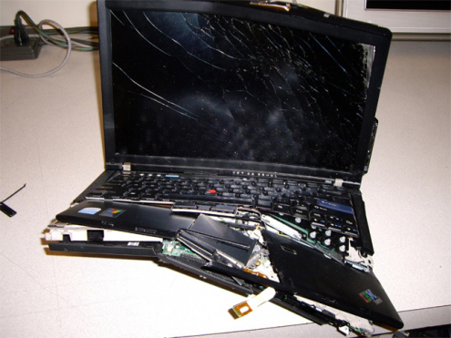
What happens if my child's laptop breaks?
Let the school TSO know as soon as possible. Laptops and batteries are covered by a manufacturer's warranty. The warranty covers manufacturer's defects and normal use of the laptop. It does not cover negligence, abuse, malicious or accidental damage.

Slide 10
What happens if the laptop is accidentally lost or damaged?
If the laptop is accidentally lost or damaged, you should tell the school TSO as soon as possible. You will need to complete and sign a Laptop Incident Report and a Statutory Declaration outlining the facts. The declaration will need to be witnessed by a Justice of the Peace or a solicitor. Your child will then be issued with a replacement at the discretion of the Principal.

Slide 11
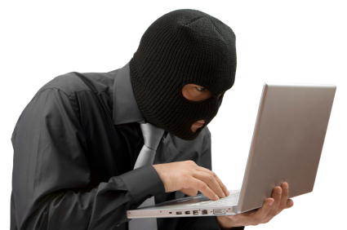
What happens if the laptop is stolen or vandalised?
If the laptop is stolen or vandalised, you should tell the police and the school as soon as possible.
The police will give you an official report number . You will need this number before a replacement laptop can be provided. You will need to complete and sign a Laptop Incident Report.

Slide 12
If the broken/missing/stolen laptop is several years old will the replacement be a newer current model?
No.
The replacement laptop will be exactly the same model, colour and technical specification as the laptop it will be replacing. A laptop reserve has been created for this purpose.

Slide 13
If the laptop is lost, damaged or stolen, what will happen to my child's schoolwork?
It is your child's responsibility to regularly save a copy of their schoolwork, also known as 'backing up' their work.

Slide 14
How should my child back up their work?
Regularly backing up work is your child's responsibility. They should save their work to their online storage area called 'My Locker'. (K:\ Drive)
At Home they can back up using a memory stick (USB drive), or an external hard disk drive.

Slide 15
What's to stop an unscrupulous student selling their laptop and then claiming it has been stolen?
All laptops have extensive hardware and software security measures. These security measures will remotely disable stolen laptops and will help to track and prosecute thieves. As soon as any laptop is stolen or lost, the school will lock it down. When the laptop is connected to the internet, even with a new operating system, it will report its location.

Slide 16
Will my child be safe carrying an expensive laptop to school?
Your child will be encouraged to keep their laptop in their school bag when travelling to and from school – using the plastic case provided. Anti-theft measures installed on the laptop remove the incentive to steal the laptop, helping to protect your child.

Slide 17
What happens if my child forgets to bring their laptop to school ?
Forgetting the laptop will be the same as leaving textbooks at home. They can participate in the lesson but perhaps not as fully as otherwise. Repeatedly leaving a laptop at home or bringing it uncharged could lead to a warning or losing the right to take the laptop home.

Slide 18
Can my child access the internet anywhere with their school laptop?
Your child can access the internet at school. School networks are wireless, which means within a certain geographical boundary (usually classrooms, the library and the school grounds), students are able to use their laptop to login to the school portal without needing to plug in any cables.

Slide 19
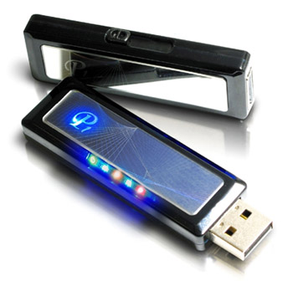
Can my child access the internet at home with their school laptop?
If you have a broadband internet connected at home, your child can use that to connect to the Internet. If you don't have access to the internet at home, your child can still use the software on their laptop to work on their schoolwork.
NOTE – the laptop will not work with Telstra 3G wireless or other similar systems as these systems require the use of an external USB modem which will not work with the laptop.

Slide 20
Is my child protected when using the internet at school? What about at home?
Your child is protected when using their laptop at school and at home by filters that block inappropriate internet material. A record of every website that the student visits is kept and can be investigated if necessary.

Slide 21
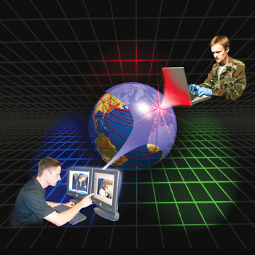
What about cyber-bullying and internet chat room protection with the Laptop?
The Bluecoat internet filter system blocks all social networking and chat sites.
Naturally we cannot control your home computer use, which is under parental control.

Slide 22
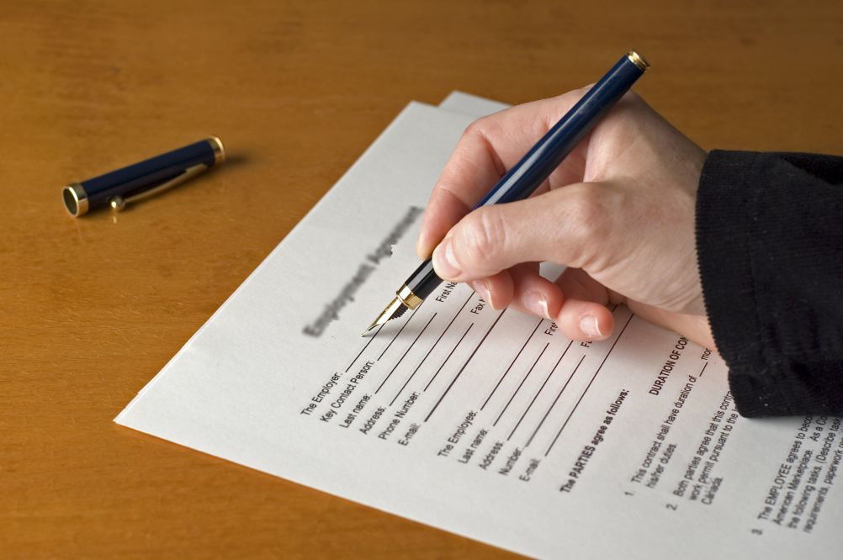
All students are required to sign an Acceptable Use Agreement for school computer use
One of the policies in this agreement is that they must not involve themselves in any sort of cyber-bullying/harassment. This is outlined on the back of the Digital Education Revolution – Laptop user Charter that the Parent and student must sign to allow the student to be given a laptop.

Slide 23
Does my child actually own the laptop?
No.
The laptop owner is the school TSO as the DER representative at the school. Whilst the student is in a NSW Public School, the laptop is “on loan” to the student. Any breach of the laptop user charter, eg the student not obeying the teachers instructions and playing games during class, will result in the laptop being taken off the student as part of the disciplinary process at the school.

Slide 24
The laptop MUST be RETURNED to the school TSO if the following occurs....
The student leaves school before completing Yr12 and attends TAFE
The student leaves school before completing Yr12 for full-time employment.
The student leaves school and enrols in a private school.
The student leaves school and enrols in a school not in NSW.

Slide 25
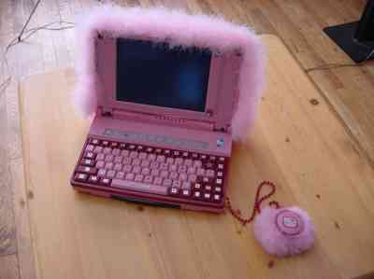
Can my child customise the laptop?
Yes, the student is able to customise the background screens and an external coloured skin will be provided that can be put on the laptop so that the student can then draw on the skin sticker to help personalise their laptop as their own.

Slide 26
Is a laptop bag or case provided for protection of the laptop?
Yes, a hardcover plastic case specifically designed for the laptop is provided. Though, should the case break, the student will be required to purchase a replacement from the school as part of their responsibility in taking proper care of the laptop. The case is not covered by manufacturer warranty.

Slide 27
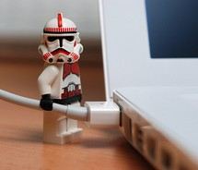
What happens if other accessories such as the battery and power cords break or are lost?
Power cords and batteries still under warranty then they will be replaced.
If the breakage is outside of the warranty period or the items are lost/stolen or there is evidence of insufficient care of the equipment, then the student will need to purchase replacements.

Slide 28
Under what circumstances will parents need to pay for repairs to or replacement of the laptop?
The laptop warranty covers manufacturer defects under normal use of the laptop. It does not cover negligence, abuse, accidental or malicious damage. E.g. Damage caused by spilling coffee on the laptop is not covered. Accidently stepping on or kicking the laptop after lying on the floor to do some work with the laptop is not covered. This is negligence and cannot be covered under warranty, as such the parent or guardian will be required to cover all repair costs of the laptop.

Slide 29
Who will be available to help my child?
Our Digital Education Revolution (D.E.R.) Technical Support Officer (TSO), will help resolve technical problems under normal school usage.

Slide 30
TSO Support
The Technical Support Officer for the laptops, is responsible for the software and hardware support of the laptop for school use only. But NOT physical or warranty repairs.
The TSO is NOT responsible for any issues which occur outside of normal school usage. E.g. – unable to connect the laptop to your home internet or home printer or can’t play games, issues with internet filter restrictions.

Slide 31
TSO Support
All hardware and software support problems with the DER Laptops need to be reported to the TSO. The laptop is NOT to be taken to the local computer shop or anyone else.
The TSO will be available full time on normal school days.
There is no after-hours or home support.

Slide 32
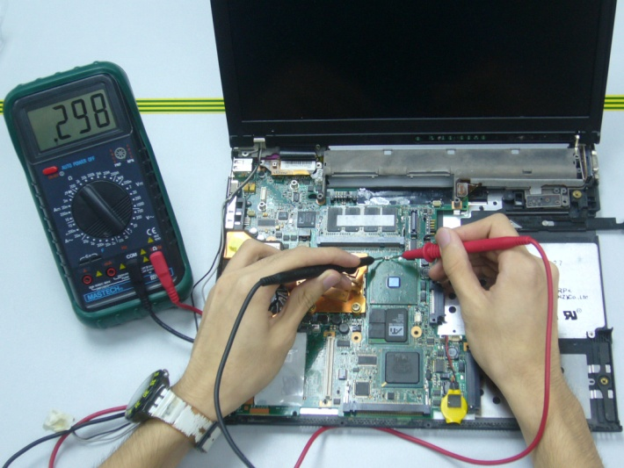
TSO Support
If the laptop needs warranty or non-warranty repairs, then it is organised by the TSO to be sent away to the official contractor who is responsible for repairs. The repair time can take several weeks, so during this time the student will be able to use another laptop, exactly the same, “On Loan” from the TSO, while the original laptop is being repaired.

Slide 33
What will lessons be like with the laptops?
Already at Killara High a transformation is taking place which is promoting the increasing use of the laptop during class lessons.

Slide 34
If I buy a laptop from Harvey Norman can my child use it at school on the DER wireless network?
Unfortunately No. Only DER provided laptops are permitted to be connected to the new wireless network due to project polices, system security, duty of care and other issues.

Slide 35
Externally purchased laptops
However, an externally purchased laptop, may be connected to the current school computer network at the discretion of the school computer co-ordinator. But any software needed by the student, must be purchased by the parent, it will not be provided by the school.
Any hardware/software or warranty issues will need to be returned to the place of purchase to be repaired. The school TSO will only be supporting the DER laptops.

Slide 36
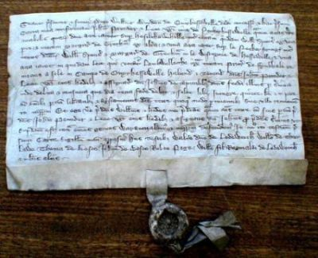
What you need to do
Parent/Carer and Student need to read carefully then sign the Digital Education Revolution – Laptop User Charter and return it to the school by the due date.
Also take into consideration all the issues we have covered in this presentation – especially costs of repairs/replacements that are not covered by warranty

Slide 37
What you need to do...continued
Understand the costs of ownership of the laptop and the policies within the User Charter.
If a signed form is not returned, then the student will not be given a laptop.
Other Choices – school use only

Slide 38
Access to and the use of the laptop is a student privilege and not a right…
The Principal and Deputy Principal’s can decide to withdraw student access to a laptop or the permission to take a laptop home in certain circumstances which may include :-
Repeatedly not bringing the laptop to school for lessons
Abusing the use of the laptop, any inappropriate use of the laptop as outlined in the User Charter, not following the teacher’s instructions during class regarding the laptop.
Not caring for the laptop responsibly
Continued incidents of loss or damage
Truanting or refusing to attend school
Breaching the signed Laptop User Charter policies
Breaching the school policies on computer use

Slide 39
Our expectations
Students will bring laptops to school every day
Laptops will be fully charged every night
Normal discipline procedures will be applied for inappropriate use.

