Slide 1
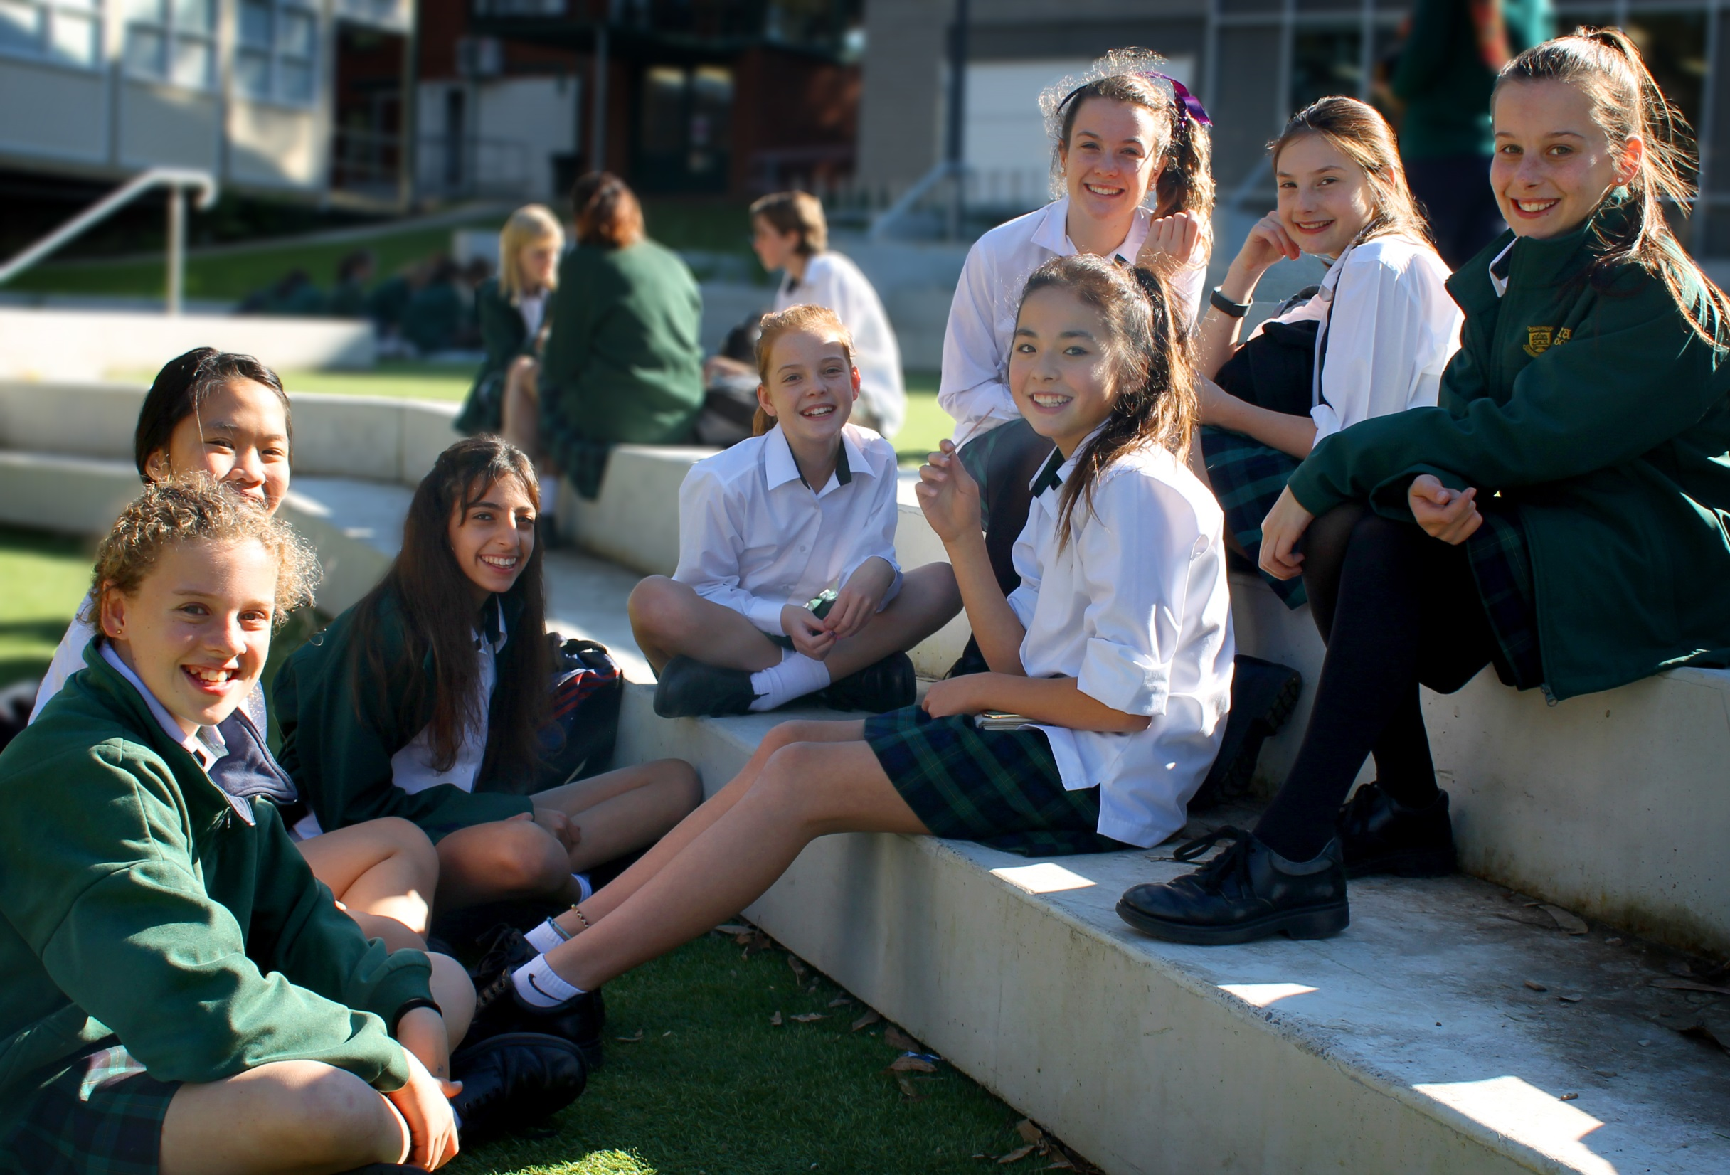
Welcome Year 7 families

Slide 2
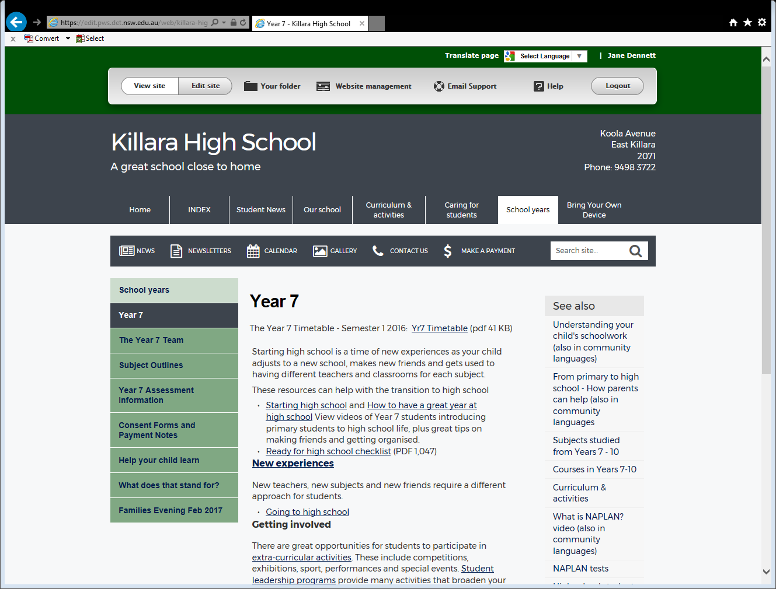
There is no need to photograph this presentation – it can be found on the KHS website → School Years → Year 7 → Families Evening Feb 2017

Slide 3
Principal – Jane Dennett
Some answers to possibly FAQs
We are working with Transdev continually to improve bus service
An acronym guide can be found on the KHS website: School years → Year 7 → What does that stand for?
It is really important to know that we are zero tolerance on violence of any kind
We simply don’t have enough power points to allow BYOD charging ☺
__________________________________________________________________________________________

Slide 4
Year 7 Deputy Principal – Carla Marchesin
Facebook: https://www.facebook.com/killarahighschool.edu.au/
KHS website:
http://www.killara-h.schools.nsw.edu.au/
Email:
killara-h.school@det.nsw.edu.au
Phone: 9498 3722
__________________________________________________________________________________________

Slide 5
Year 7 Deputy Principal – Carla Marchesin
Student Progress Review Meeting
Wednesday 29 March (Week 10) in the Kerrabee Hall
5 minute interviews
Appointments made online – email will be sent
Longer interviews can be held at other times
__________________________________________________________________________________________

Slide 6
Year 7 Deputy Principal – Carla Marchesin
Interim Reports
Issued in late March
They will indicate if an interview is required, requested or optional
__________________________________________________________________________________________

Slide 7
Stage 4 Head Teacher – Julie Phelan
Attendance
Diaries
Homework
Assessments and Examinations – note that all assessments are on the school calendar
__________________________________________________________________________________________

Slide 8
Head Teacher Student Wellbeing –
Clair-Louise Schofield (Rel.)
Home Groups, Prefects and Peer Support
Illness at school – always report to the office
Honour System
Level and Discipline system:
KHS website: →Our School →Rules & policies →Discipline & Effective Learning
or in the School Diary
__________________________________________________________________________________________

Slide 9
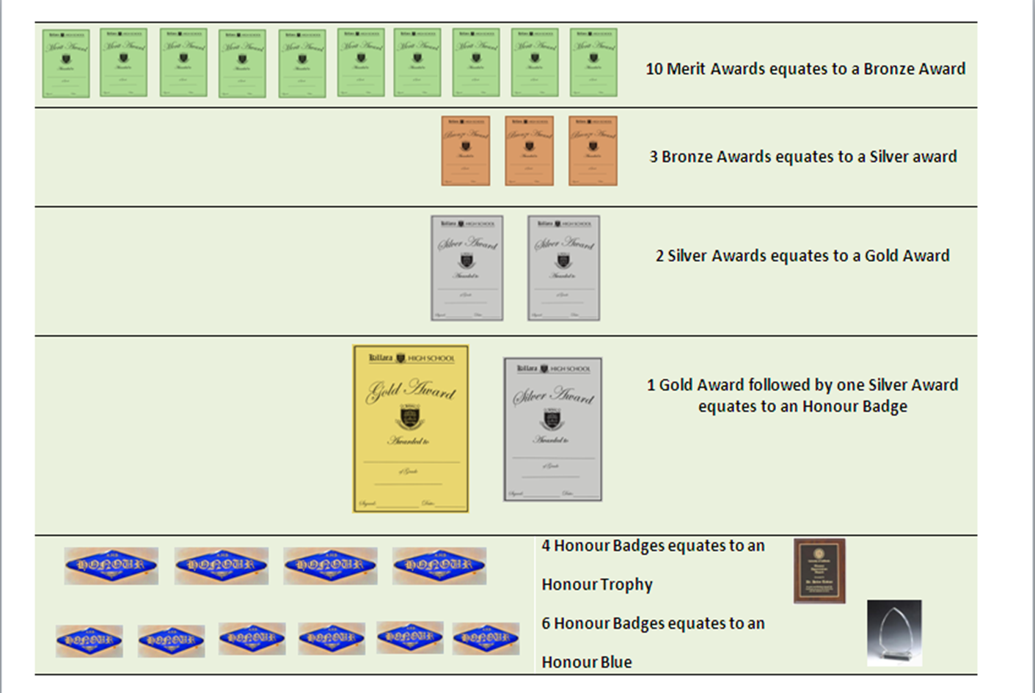

Slide 10
P & C Vice President – Megan Guenther
P & C meetings are held twice a term, generally on the third Wednesday of each month, commencing at 7.00pm in the Staff Common Room
Term 1 Wednesday, February 15 Wednesday, March 15
Term 2 Wednesday, May 17 Wednesday, June 21
Term 3 Wednesday, August 16 Wednesday, September 13
Term 4 Wednesday, October 18 Wednesday, November 15
__________________________________________________________________________________________

Slide 11
__________________________________________________________________________________________

